Slide 1


MACRO MOBILITY
Presented By : Harsh Patel, Siddhant Pasi

Slide 2
INTRODUCTION
In today's mobile-centric world, the seamless mobility of devices across networks is essential. Mobile IPv6 (MIPv6) and Fast Mobile IPv6 (FMIPv6) are protocols designed to address the challenges of mobility in IPv6 networks. They ensure uninterrupted connectivity and communication for mobile devices as they move between different access points.
UCoE| 2024

Slide 3

1
OVERVIEW
Introduction
Methodology
Result
Literary Review
MIPv6
Conclusion
Theoretical
Thank You
Recommendation
UCoE | 2024

Slide 4
2
INTRODUCTION
Macro mobility: Long-distance movement, cities, regions, countries, transportation modes, air travel, railways, highways, maritime shipping, urban planning, infrastructure, policy-making, economic trends, technology, environment, societal preferences.
Larana University | 2024

Slide 5

3
THEORETICAL FRAMEWORK
Overview
Mobile IPv6 uses a hierarchical addressing system with permanent home and temporary care-of addresses to facilitate seamless mobility.
Proponents
Mobile IPv6 employs a binding update mechanism for mobile nodes to update their location information, ensuring uninterrupted connectivity and efficient packet routing.
UCoE | 2024

Slide 6
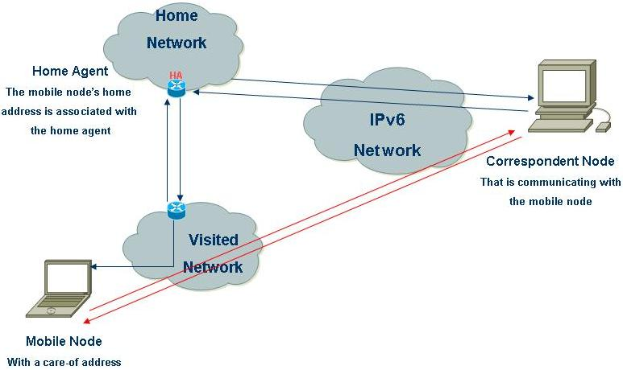
4
METHODOLOGY
UCoE | 2024

Slide 7
5
MIPV6
A communications protocol that provides an identification and location system for computers on networks and routes traffic across the Internet.
Designed to address IPv4 address exhaustion by providing a much larger pool of addresses for the Internet.
UCoE | 2024

Slide 8
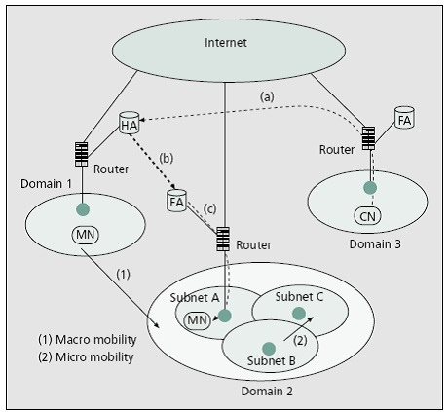
6
WORKING OF MACRO MOBILITY
The CN sends the header to the FA.
FA sends that packet to the HA of MN in home network.
Through encapsulated the packet is send to the 3 domain where the MN has moved.
The packet is decapsulated.
UCoE | 2024

Slide 9
7
UCoE | 2024

Slide 10
8
CONCLUSION
In conclusion, macro mobility is vital for global connectivity, economic growth, and cultural exchange. However, its rapid expansion brings challenges like congestion and pollution, demanding sustainable solutions. Embracing technology such as electric vehicles can mitigate these issues. A holistic approach prioritizing environmental sustainability and social equity is crucial for resilient societies.
UCoE| 2024

Slide 11
UCoE | 2024
THANK YOU
Presented By : Harsh Patel, Siddhant Pasi

